Slide 1
Mastering the Game of Go with Deep Neural Networks and Tree Search
Выполнил:
Мищенко В.А.
2016 г.

Slide 2
Авторы
David Silver, Aja Huang, Chris J. Maddison, Arthur Guez, Laurent Sifre, George van den Driessche, Julian Schrittwieser, Ioannis Antonoglou, Veda Panneershelvam, Marc Lanctot, Sander Dieleman, Dominik Grewe, Nal Kalchbrenner, Timothy Lillicrap, Madeleine Leach, Koray Kavukcuoglu, Thore Graepel, Demis Hassabis – Google DeepMind.
John Nham, Ilya Sutskever – Google.

Slide 3
New Methods
A new approach to computer Go that uses value networks to evaluate board positions and policy networks to select moves.
A new search algorithm that combines Monte-Carlo simulation with value and policy networks.

Slide 4
Deep convolutional neural networks
They employ a similar architecture for the game of Go.
Monte-Carlo tree search (MCTS) uses Monte-Carlo rollouts to estimate the value of each state in a search tree.
They use these neural networks to reduce the effective depth and breadth of the search tree:
evaluating positions using a value network,
sampling actions using a policy network.

Slide 5
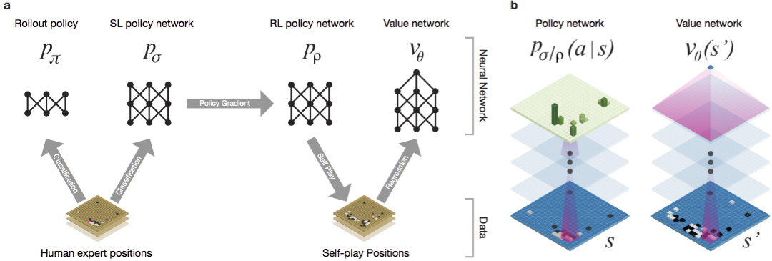
The neural networks

Slide 6
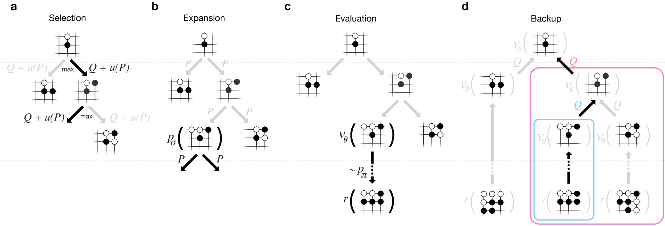
Searching with Policy and Value Networks
AlphaGo combines the policy and value networks in an MCTS algorithm that selects actions by lookahead search.

Slide 7
Discussion
They have developed effective move selection and position evaluation functions for Go, based on deep neural networks that are trained by a novel combination of supervised and reinforcement learning.
They have introduced a new search algorithm that successfully combines neural network evaluations with Monte-Carlo rollouts
AlphaGo won the human European champion (5-0)
AlphaGo is more effective than other Go programs

Slide 8
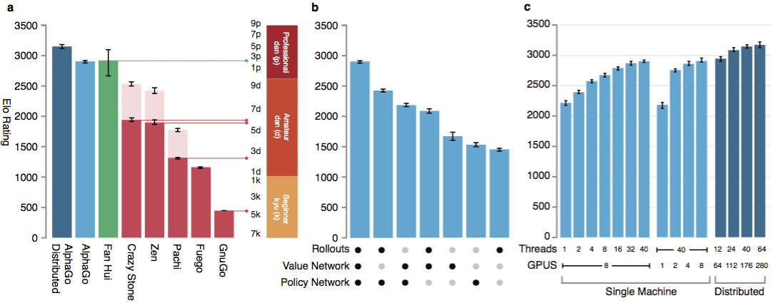
Evaluating the Playing Strength of AlphaGo

Slide 9
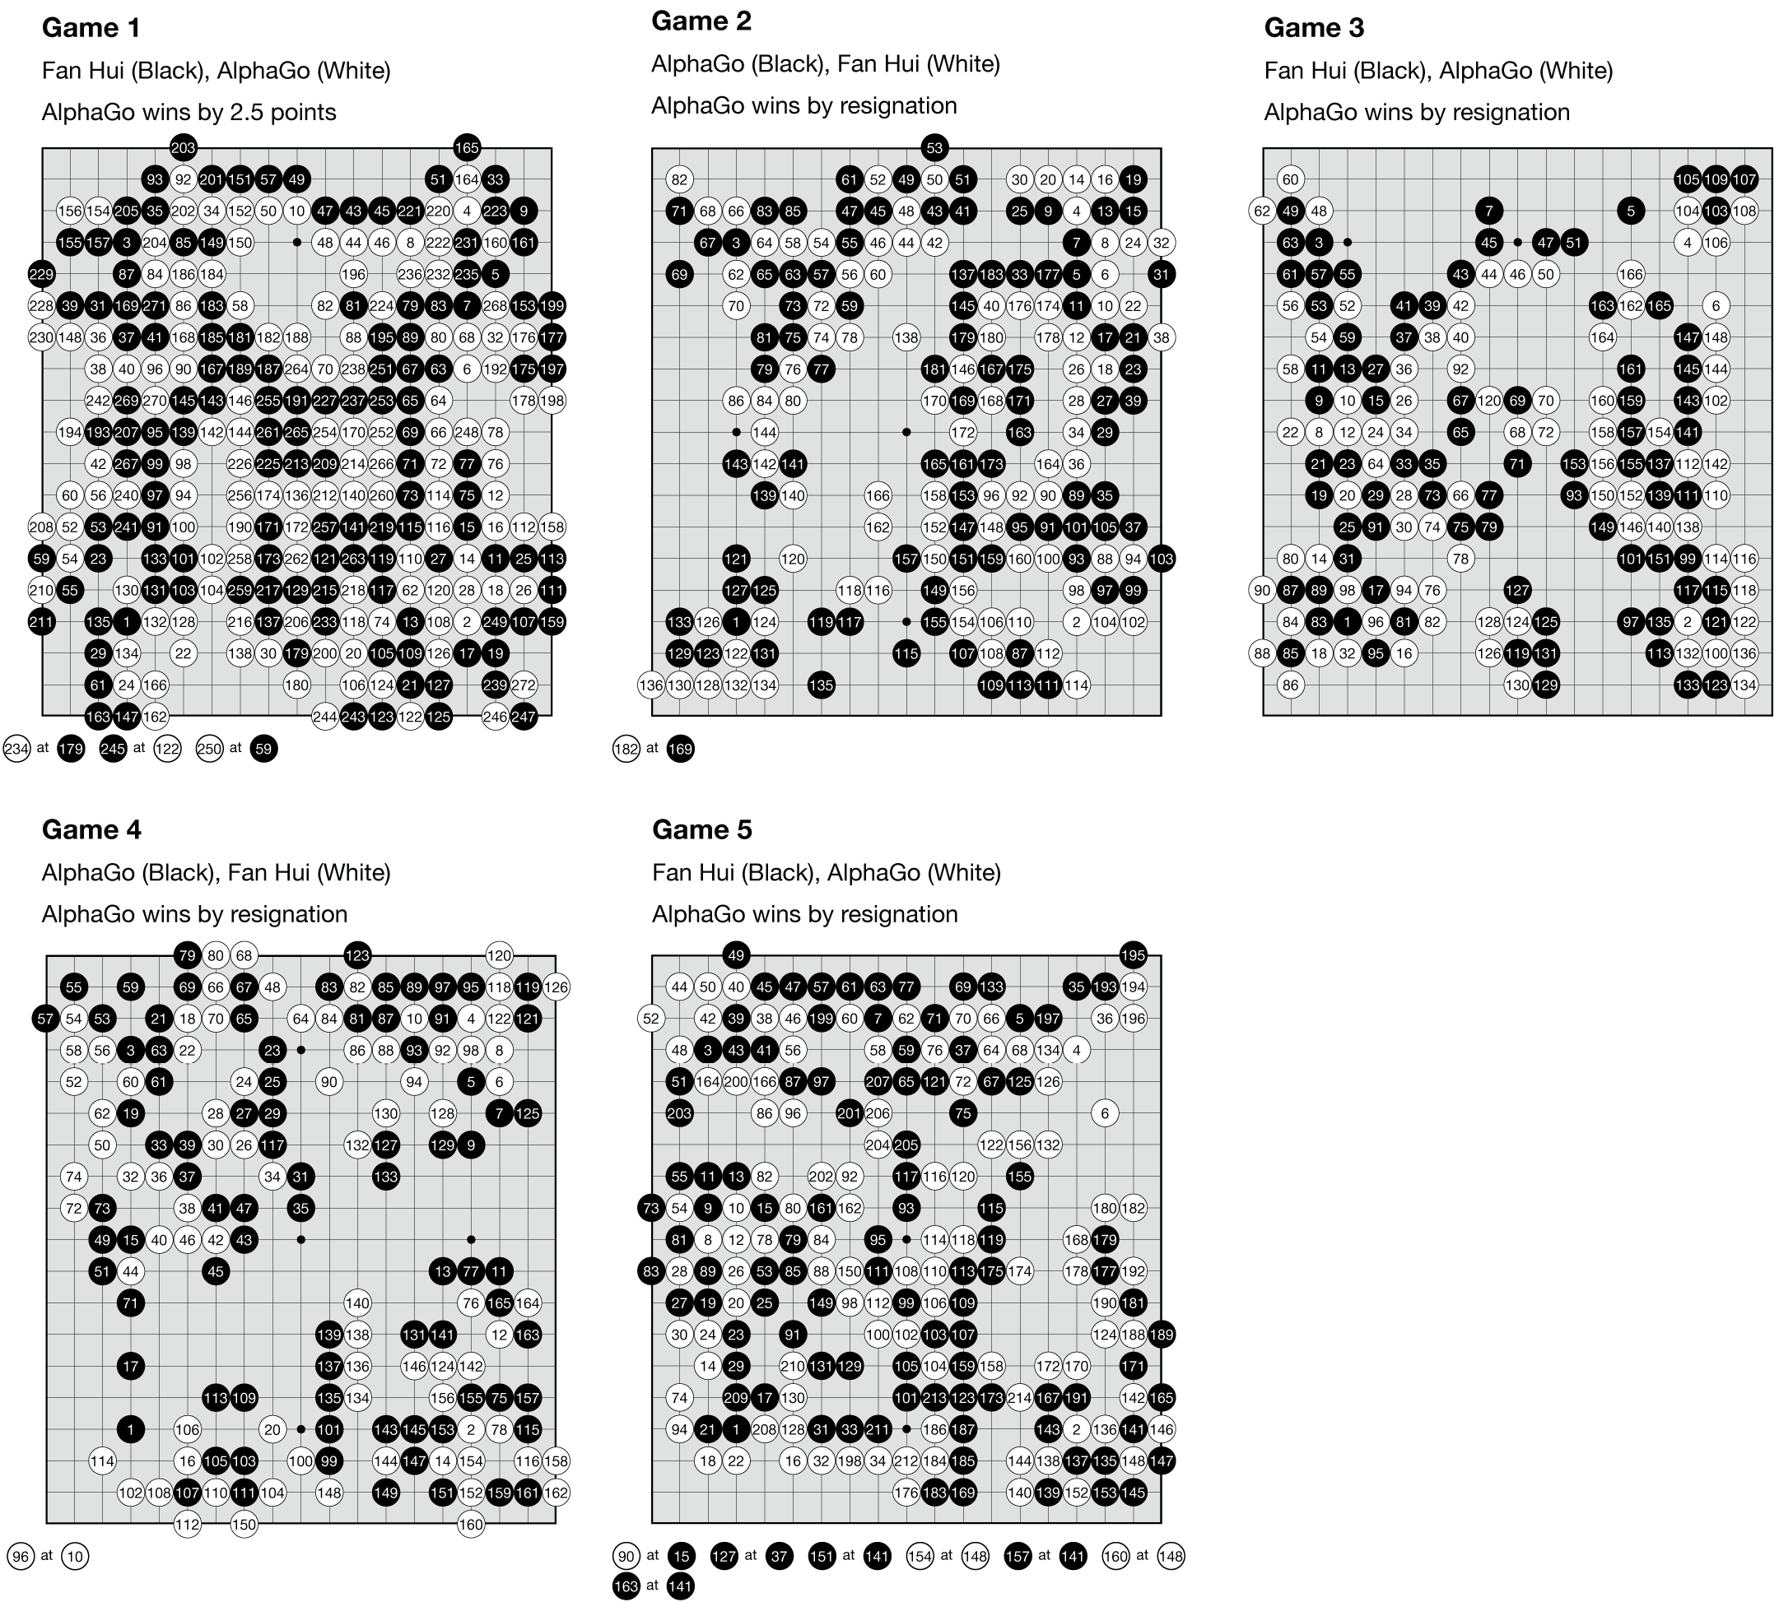
AlphaGo vs Fan Hui

Slide 10
Спасибо за внимание!

Slide 11




Functions at each step
Supervised Learning of Policy Networks
Reinforcement Learning of Policy Networks
Reinforcement Learning of Value Networks

Slide 12


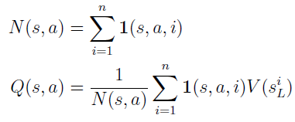

Monte-Carlo tree search in AlphaGo.
Each edge (s; a) of the search tree stores an action value Q(s; a), visit count N(s; a), and prior probability P(s; a).

